Slide 1


St Paul Shenanigans
Or a deep look into cytokines
BigData2018ubc-stPaul

Slide 2

[Navaneelan et al., Health at a Glance, Statistics Canada, 2016]
In Canada
1 of 18
Deaths are due to sepsis
33 %
Deaths within 1st month

Slide 3

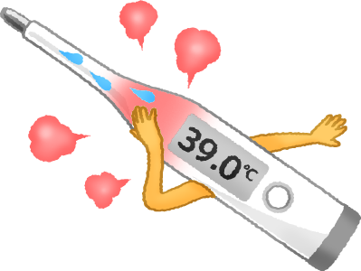
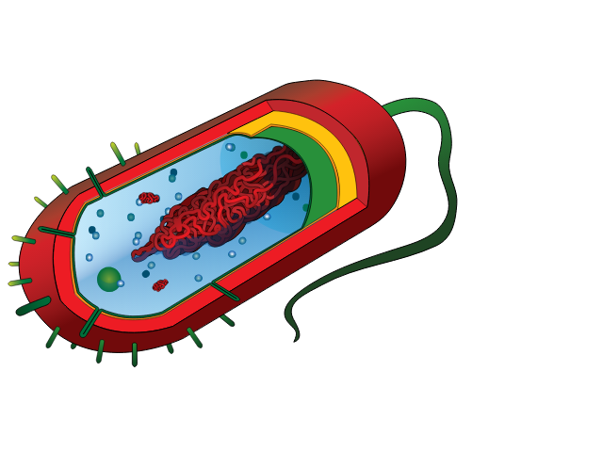
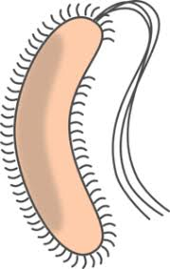
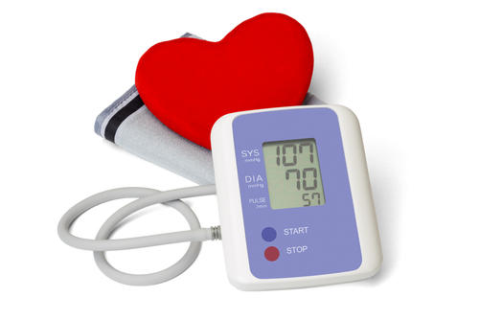
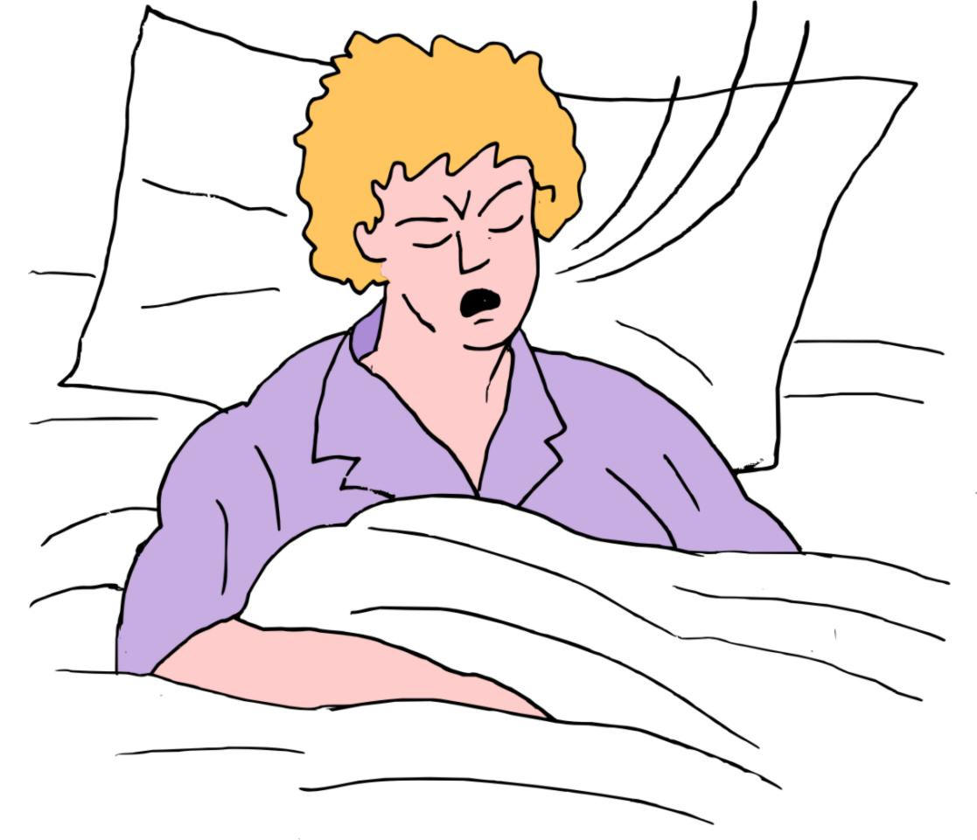
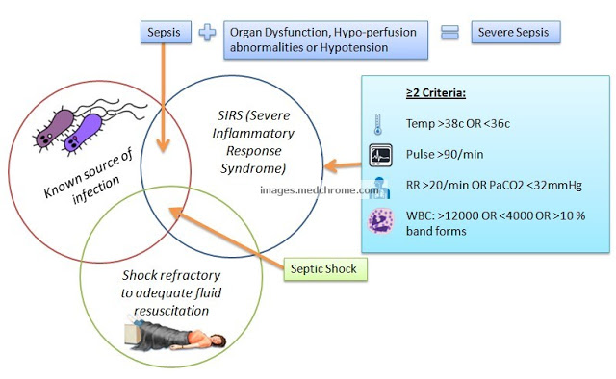
Septic shock: any cytokines involved?
Septic shock: any cytokines involved?
Sepsis
No response to therapy
Septic shock
Notes:
Introduce sepsis after two circles overlap;
Then show the third circle and introduce septic shock.

Slide 4

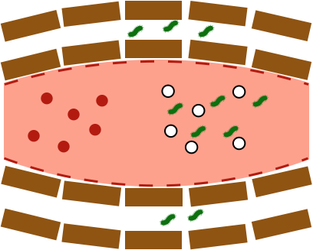
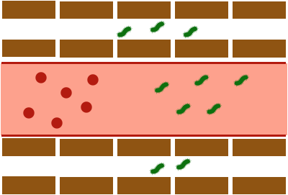
What is Septic shock?
source
Red blood cell
Tissue cell
Infectious cell
White blood cell
This process is meditated by small proteins called cytokines
Lack of oxygen delivery to tissue

Slide 5
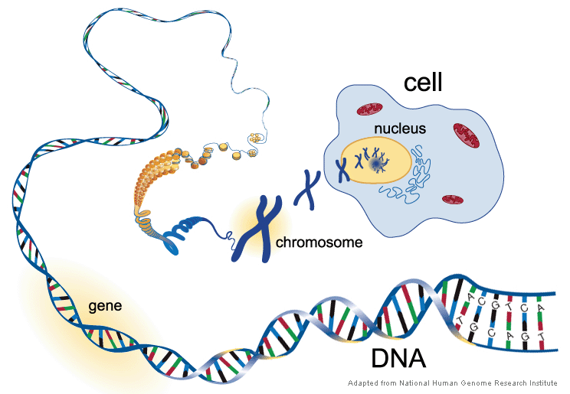
All the information is in the DNA

Slide 6
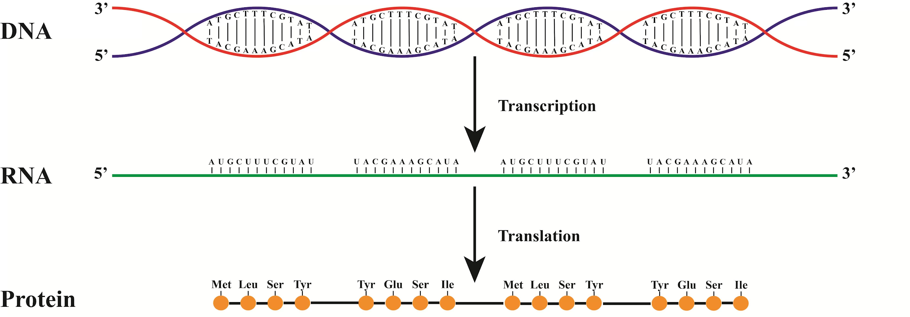
Central Dogma (DNA → RNA → Protein)
Cytokines are proteins!

Slide 7
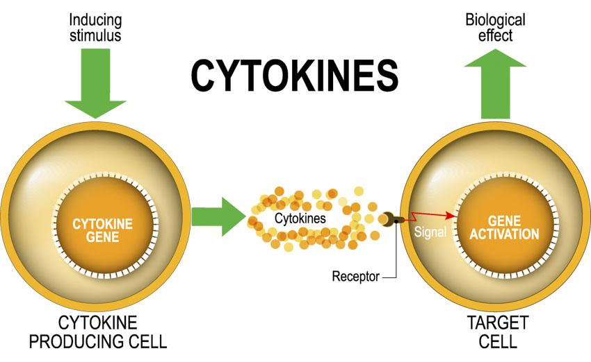
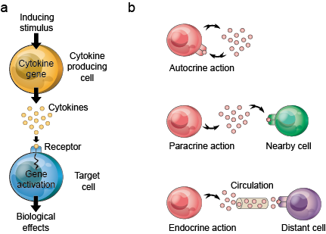
What are cytokines?
Cytokines - are small proteins that mediate cell signalling e.g IL1, MIP1A
Notes:
IL: interleukin, MIP: Macrophage inflammatory protein

Slide 8
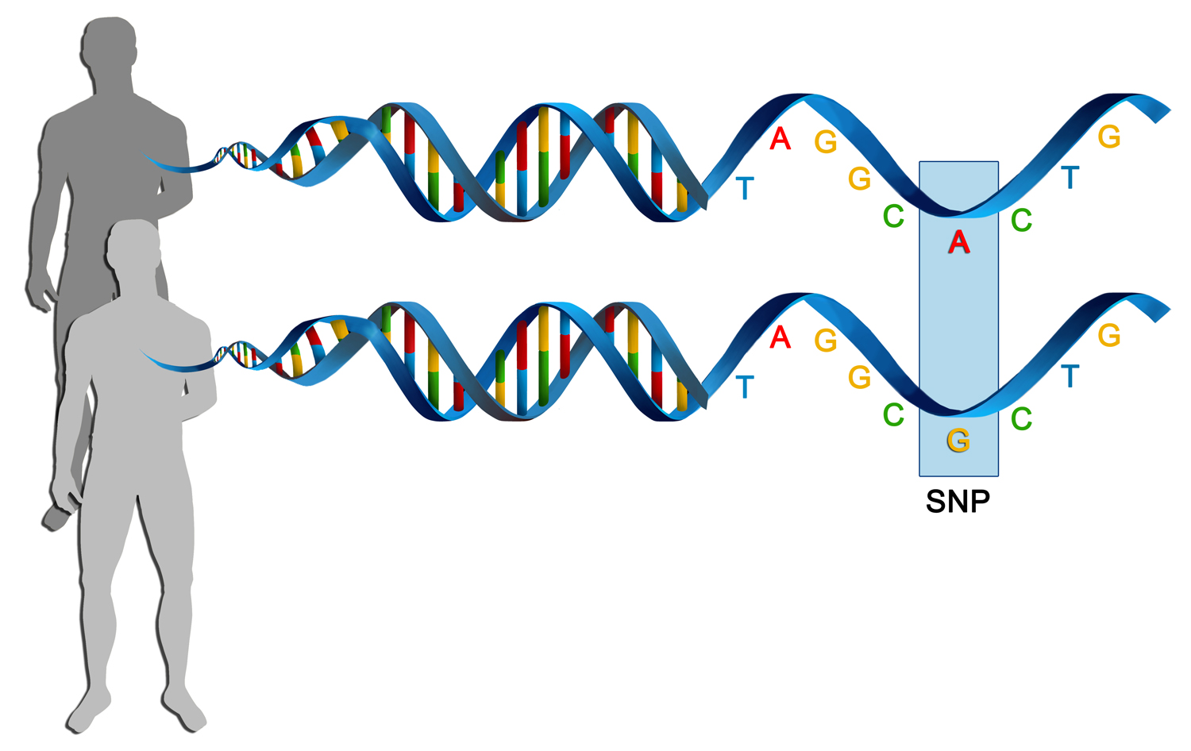
Single Nucleotide Polymorphisms (SNPs)
SNPs (snips), aka
“one – nucleotide mutation” e.g. rs123456
Certain SNPs can modify cytokine levels.

Slide 9
Correlation does not imply causation
Hidden Variable
Cytokines
?
Death

Slide 10
SNPs can help reveal causal relationships
Hidden Variable
SNPs
Cytokines
Death
Hidden Variable
Cigarette Tax
Cigarettes
Death

Slide 11
Three points of investigation
SNP
Cytokine
Death
3
1
2

Slide 12
Cytokine level → Death
SNP
Cytokine
Death

Slide 13
Our Dataset
Data originated from VASST study to determine effects of a certain vasopressin treatment on health outcomes of septic patients
Type of data arising from 330 septic patients:
Blood serum concentration measurements of 52 cytokines per patient
Approx. 1.2 million SNP measurements for each patient

Slide 14
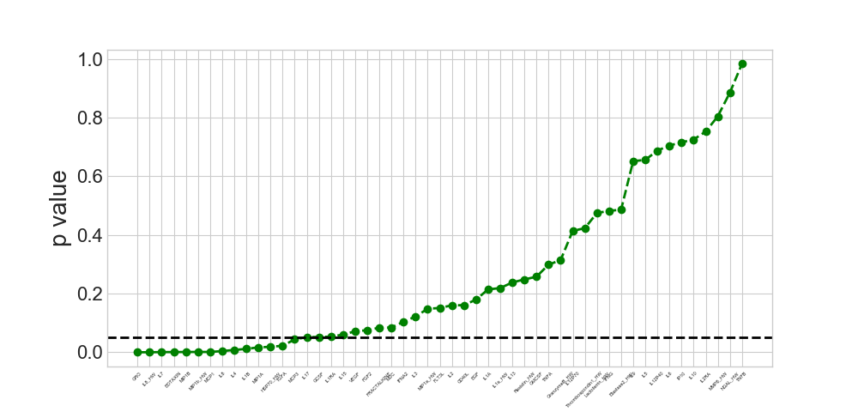
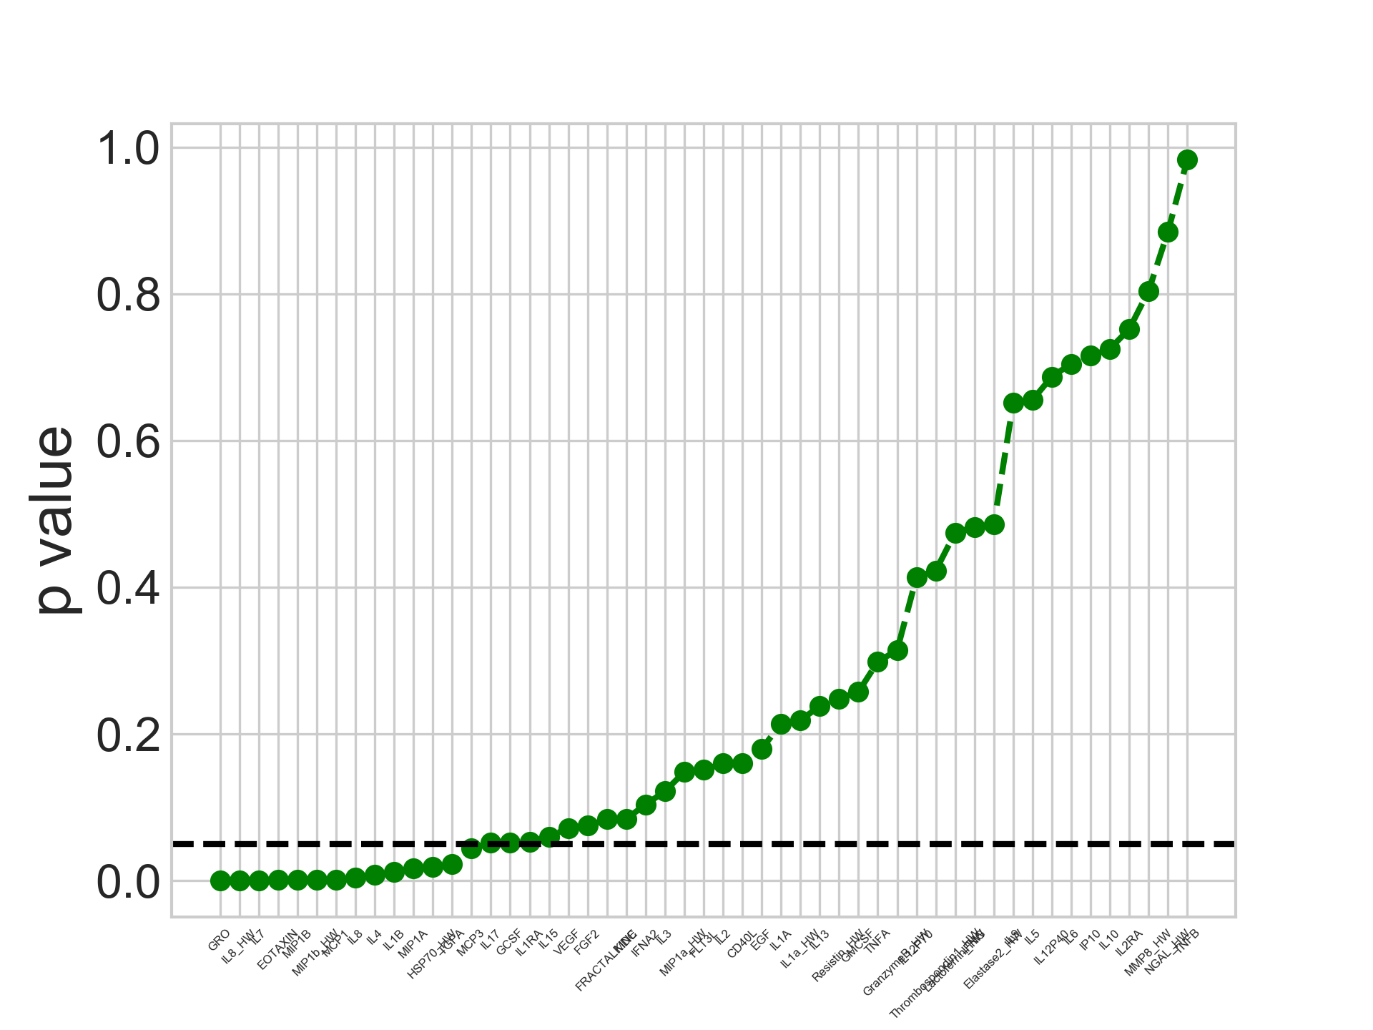
Finding “culprit” cytokines
Cytokines

Slide 15
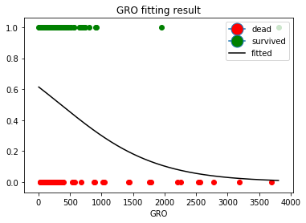
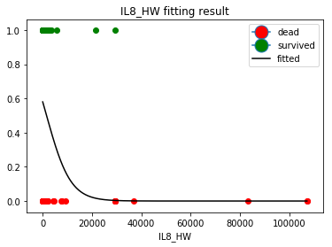
Logistic regression
Single variable
L1 loss, higher weight for death cases, inv regularizer=0.5
Error usually one-sided:
Train accuracy 0.73333 Test accuracy 0.71429
Train accuracy 0.73846 Test accuracy 0.69388

Slide 16
Other models
Multivariable logistic regression:
Using only “useful cytokines”: Train accuracy 0.70588, Test accuracy 0.67568
Using all cytokines: Train accuracy 0.75000, Test accuracy 0.64000
Decision tree (depth 1 to 15):
Best: depth=5, Train accuracy is 0.78636, Test accuracy is 0.68000
Neural network:
Various configurations, train accuracy usually high, test accuracy <0.7
Challenge: overfitting due to small dataset, noise
Notes:
Noise due to inherent variance in biology means this is as good as we can expect

Slide 17
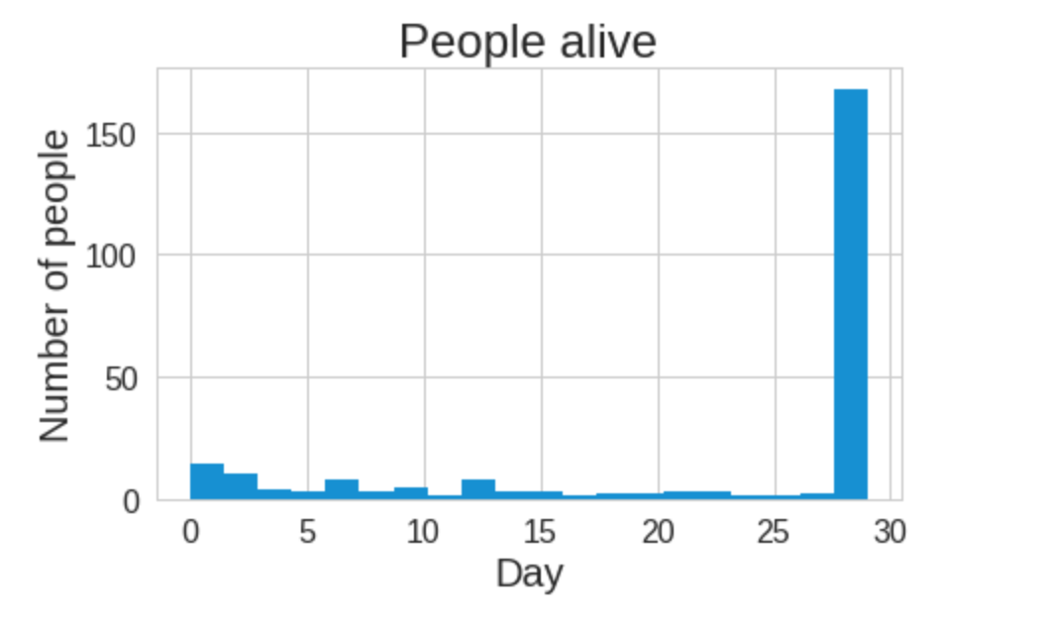
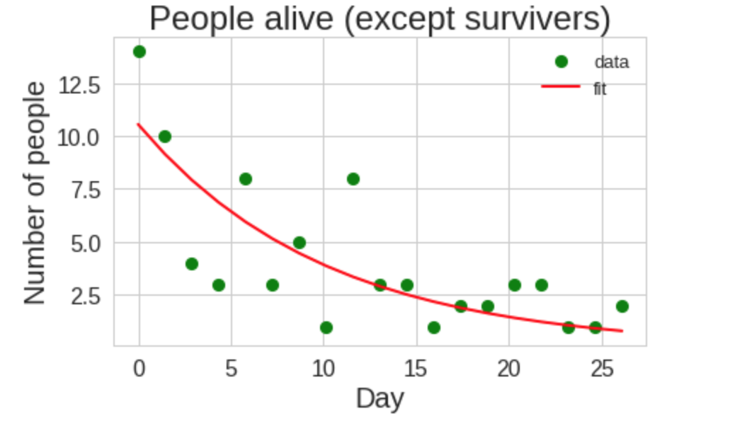
People dying (people that live this many days)
People alive (except survivors)

Slide 18
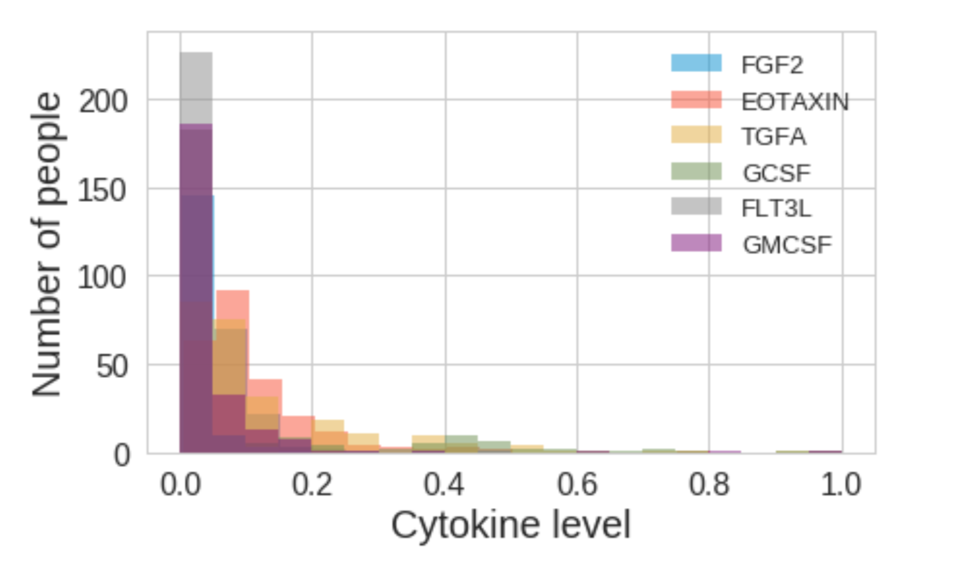
Cytokine levels among patients
0.5 quantile

Slide 19
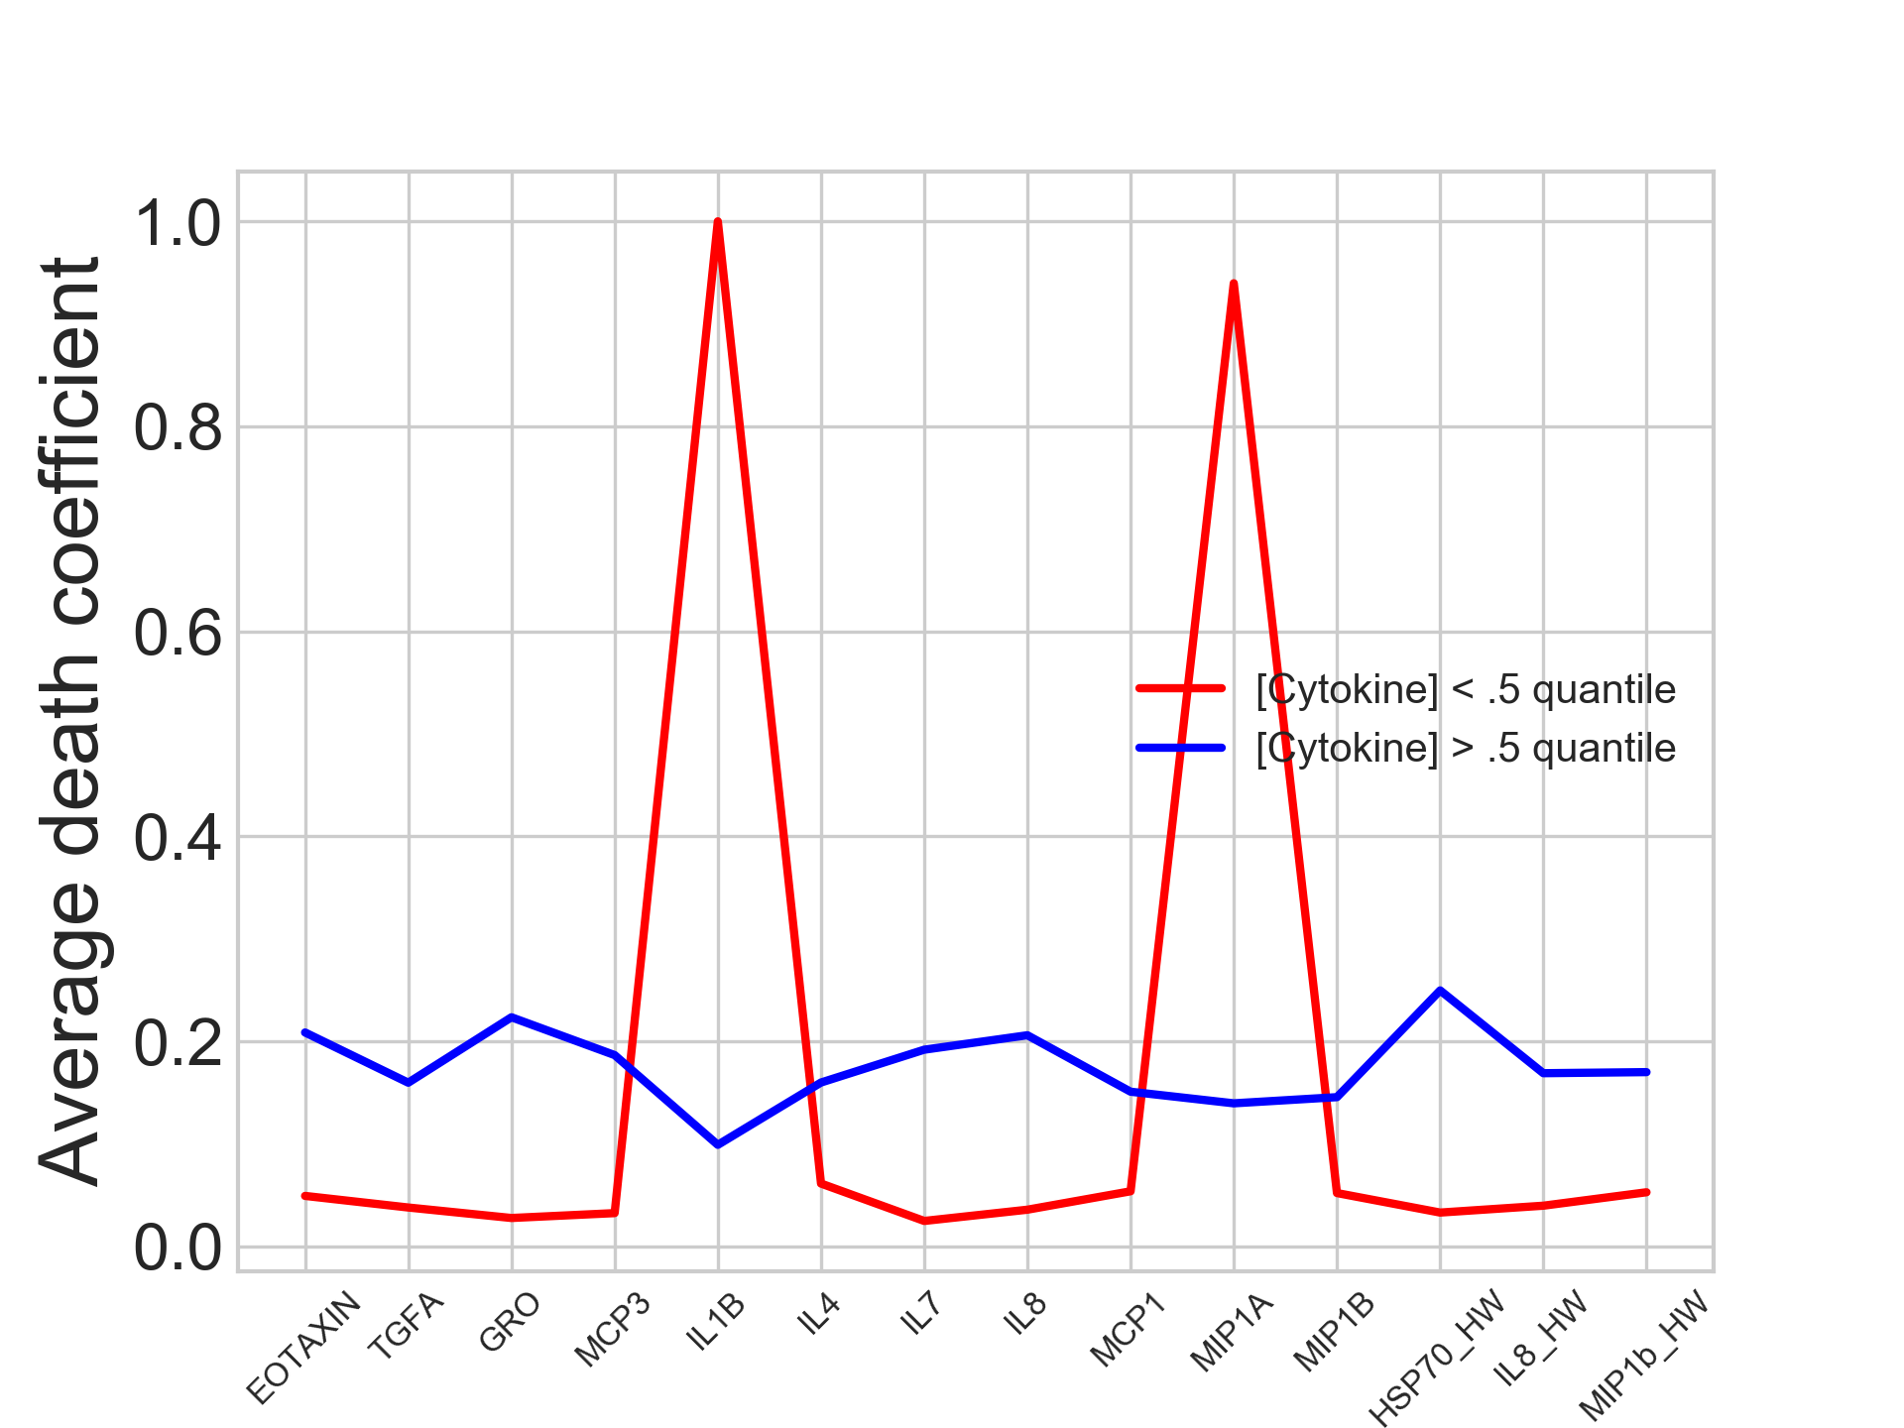
Cytokine - Death correlation

Slide 20

Culprits:
Special culprits:
IL1B
MIP1A
EOTAXIN, TGFA, GRO, MCP3, IL1B, IL4, IL7, IL8, MCP1, MIP1A, MIP1B, HSP70

Slide 21
2) SNPs → Death
SNP
Cytokine
Death

Slide 22




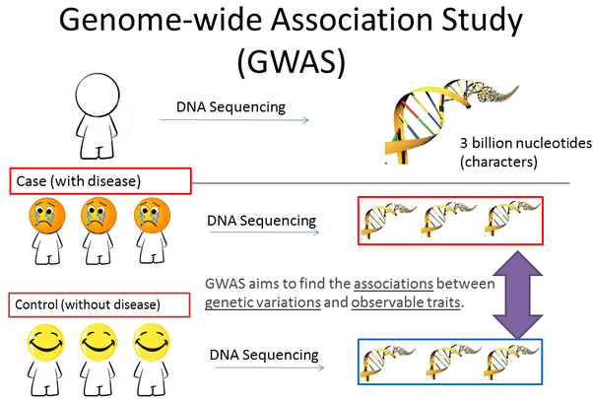
Genome Wide Association Study (GWAS)
association

Slide 23
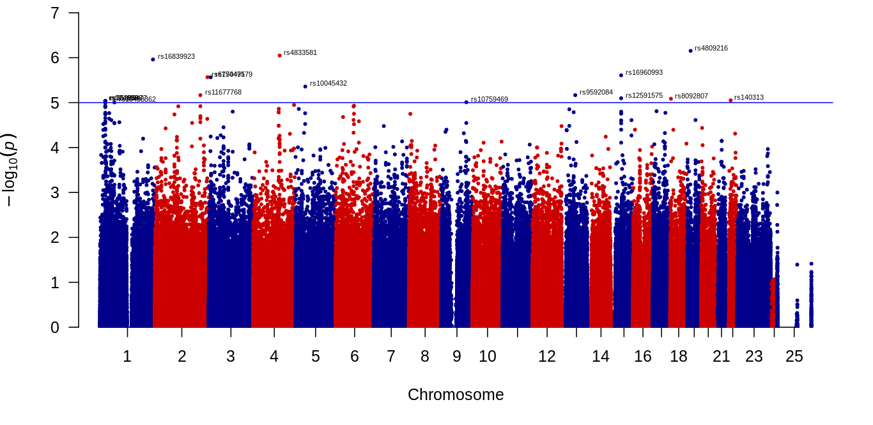
GWAS: SNP association with survival

Slide 24
3) SNPs → Cytokine level
SNP
Cytokine
Death

Slide 25
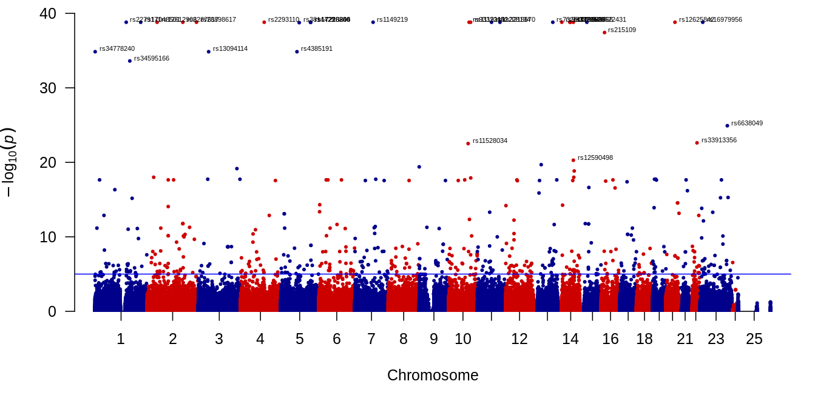
GWAS: SNP association with cytokine MCP3

Slide 26
4) Assembling results
SNP
3
Cytokine
1
Death
4
2

Slide 27
Correlating significant Cytokines with SNPs
GRO
rs4952913
TGFA
rs3920487
MCP3
rs12985626
MCP1
rs4926884
IL1B
rs11759038
MIP1A/B
[Genome browser, UC Santa Cruz]

Slide 28
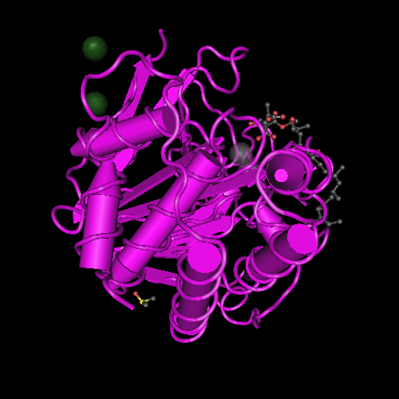
Protein phosphatase 1 regulatory subunit 21 (PP1R21)
Increases
Cytokine levels
Inhibits
PP1
PP1-R21
SNP Rs4952913
SNP present in:
GRO, MCP3, IL1B, MIP1A, MIP1B
All are proinflammatory
[Yamaoka et al., Protein phosphatase 1 is involved in IL-2-induced IL-5 andIL-13 expression in human T cells, Genes to Cells, 2012]

Slide 29
Concluding Remarks
Evidence supporting: several cytokines cause death/survival through PP1 PP1R21 mechanism
Next steps:
More data for better training the machine learning
Deep dive into investigation of PP1 and PP1R21
Connection with other inflammatory diseases
SNP
Cytokine
Death
Notes:
CYTOKINES are causing death, not just correlated! That could be potential drug targets.

Slide 30
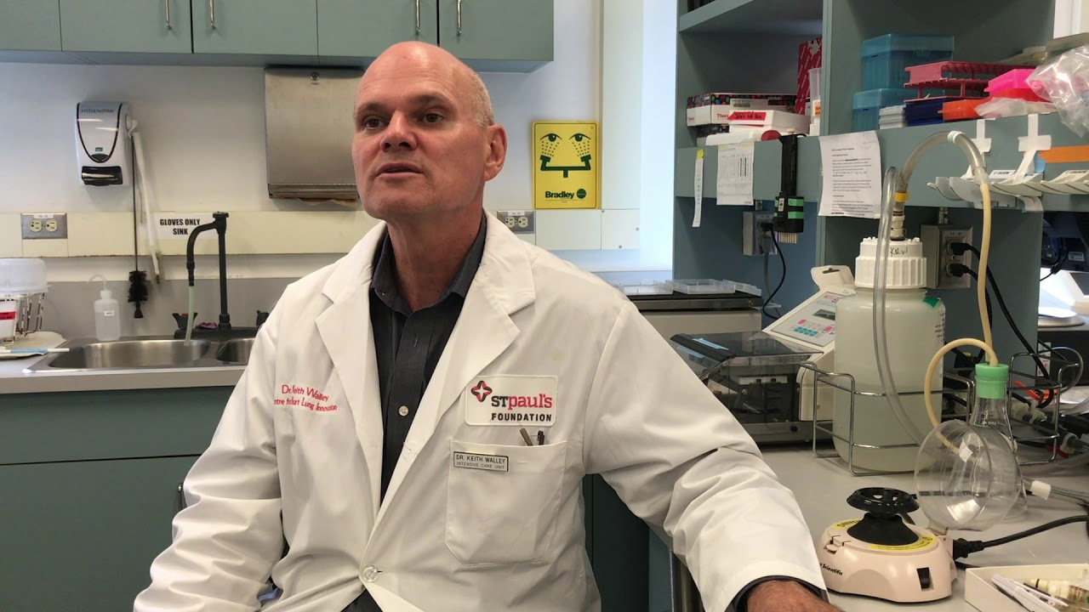
Acknowledgement
Keith Walley (St. Paul’s Hospital)
Brian Wetton
Aaron Berk
India Heisz
Matteo Lepur

Slide 31
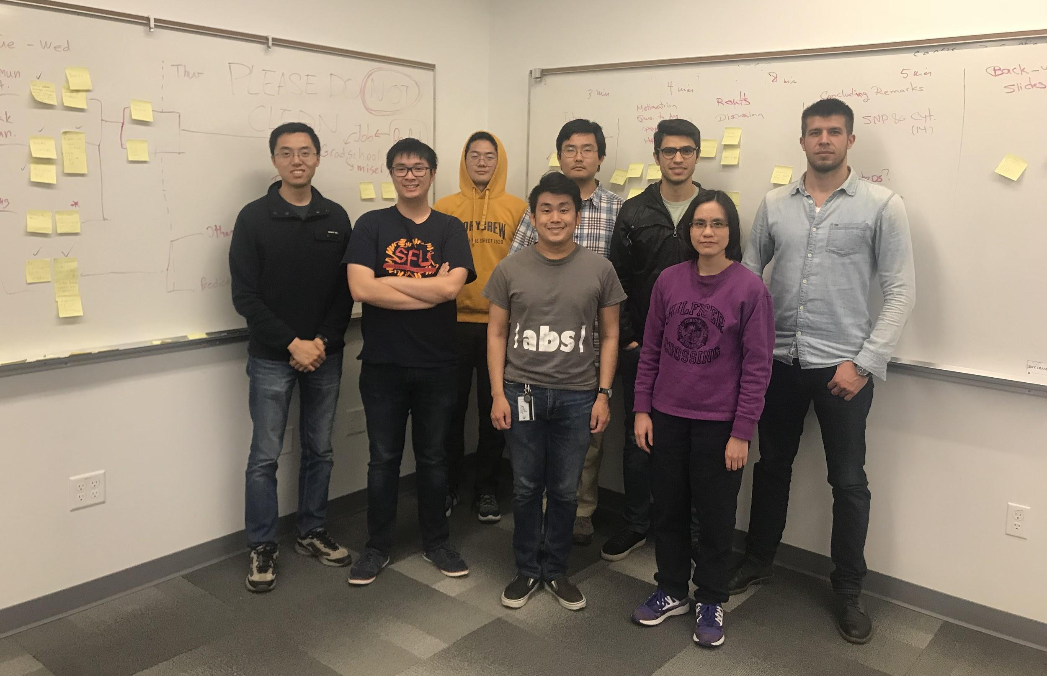
The shenanigans:
Left to right: Mingfeng Qiu, Matthew Nguyen, Bowen Chen, Sean La, Yue Liu, Babak Nasouri, Ka Mun Nip, and Vasilii Triandafilidi

Slide 32
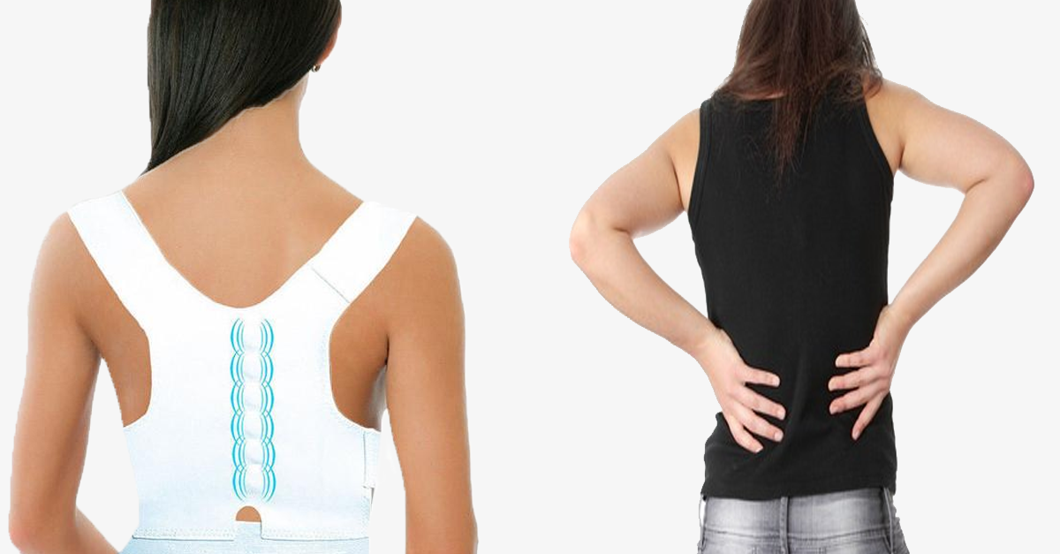

BACKUP

Slide 33
What is cytokine?
Small molecular weight proteins (~5-20 kDa) that mediates cell signaling
Secreted by cells in response to stimuli (eg. inflammation and infection)
Bind to receptors of target cells and alter their gene expression

Slide 34
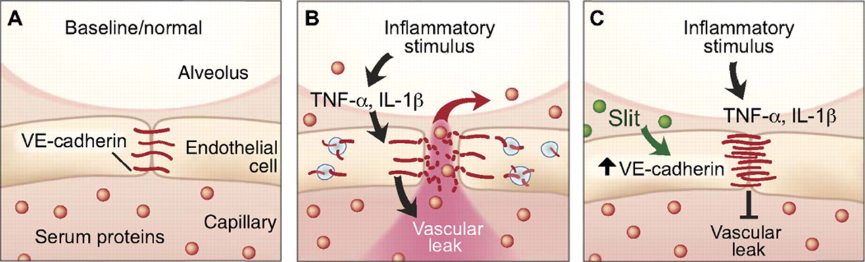
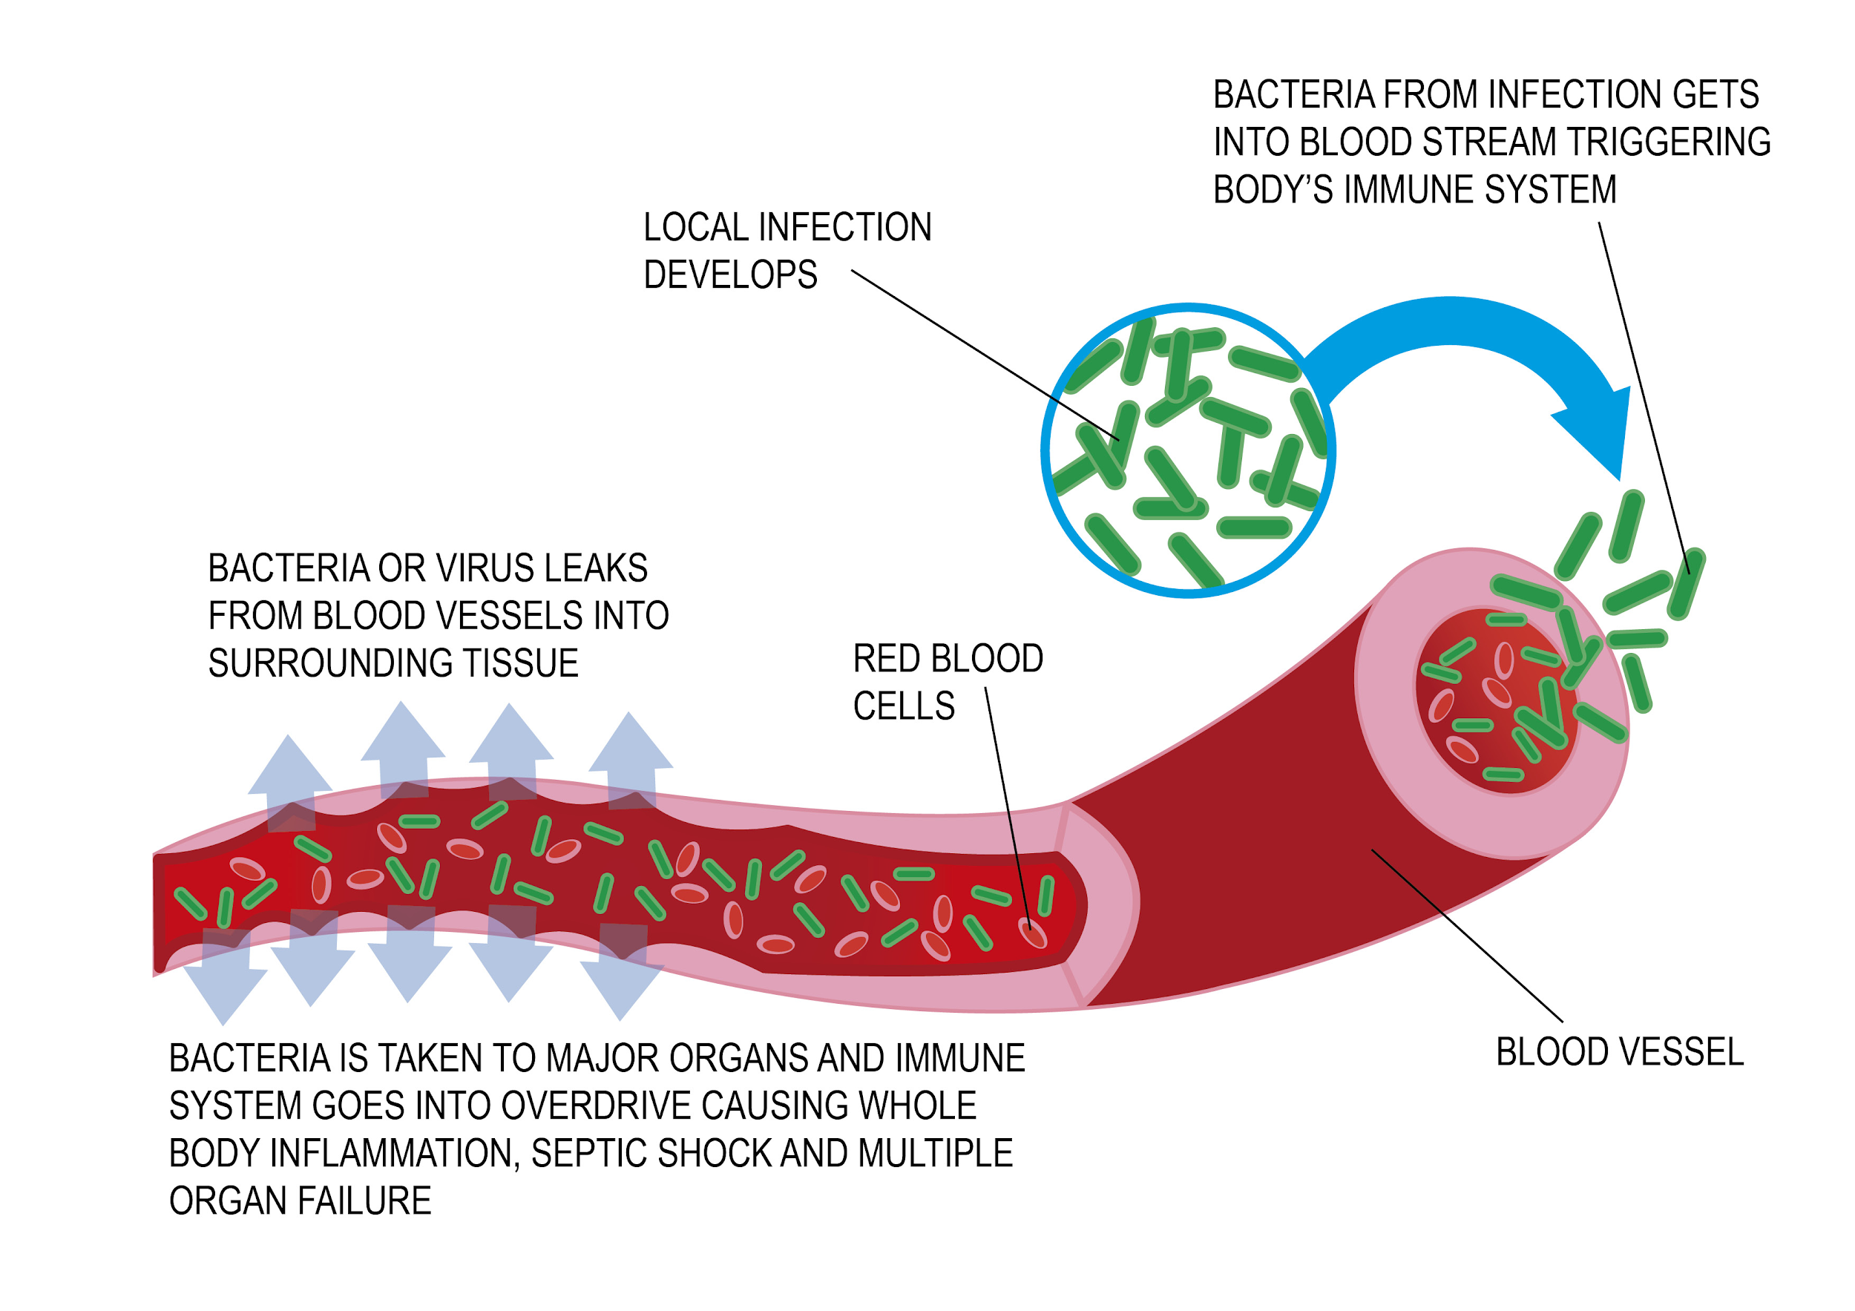
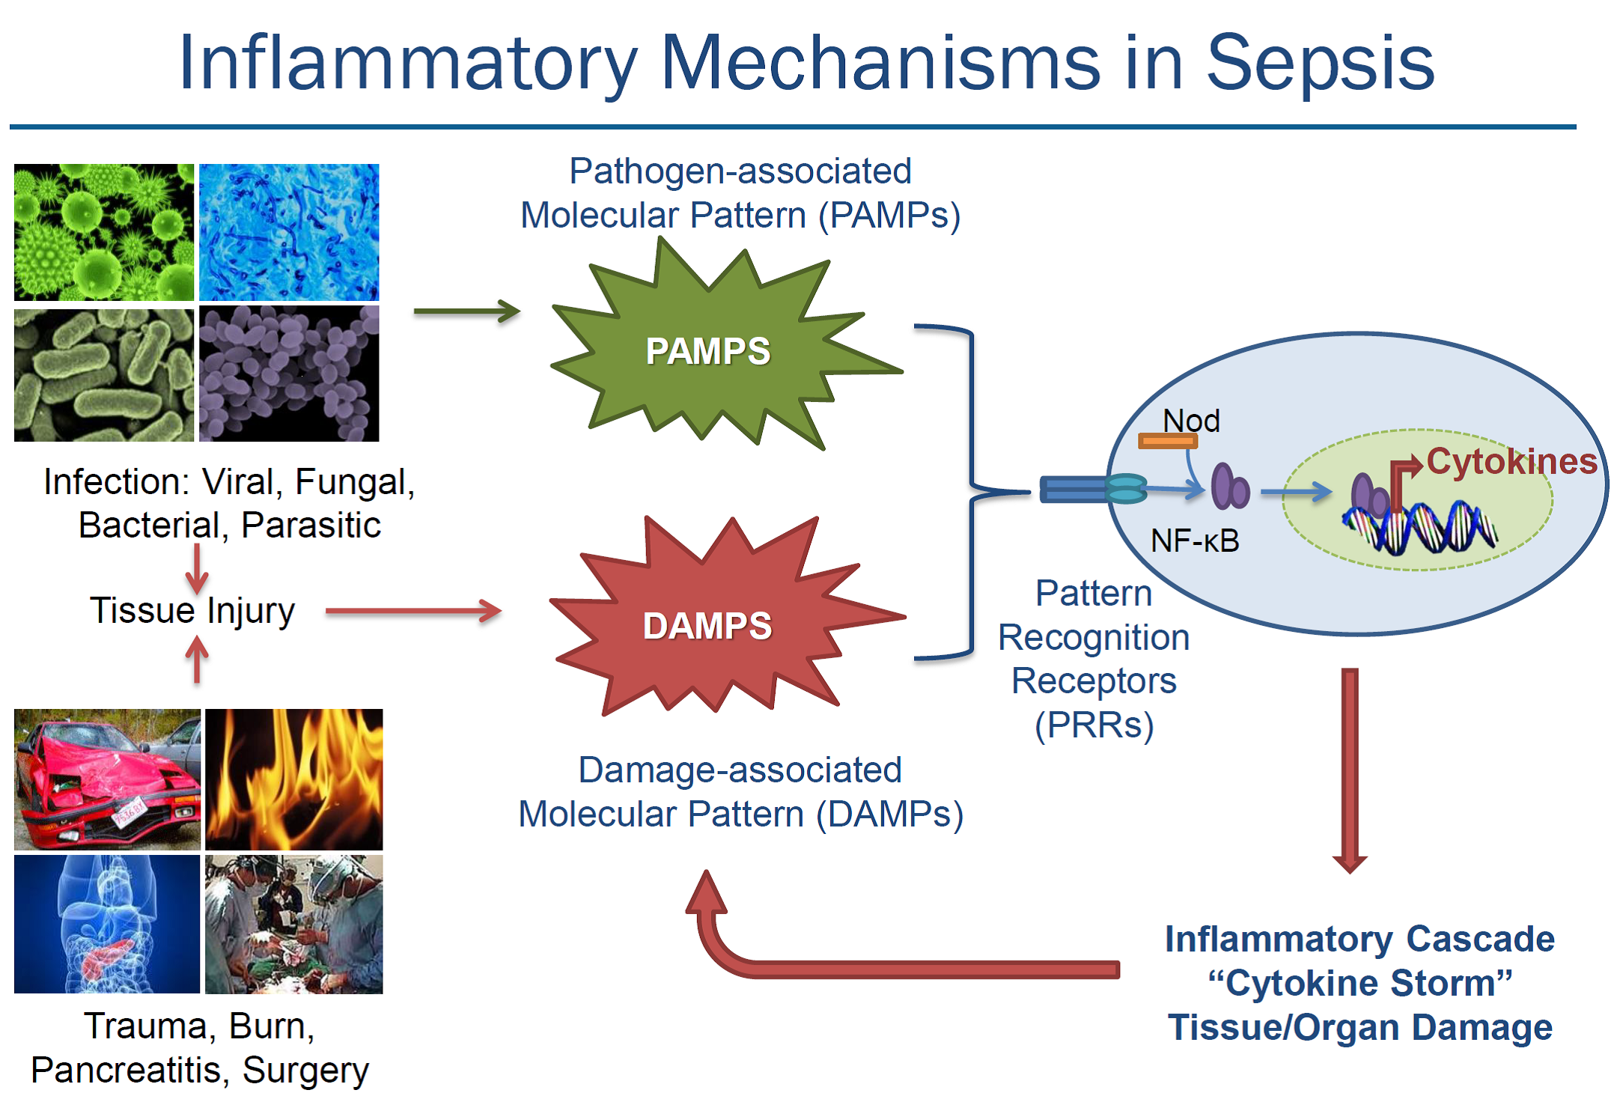
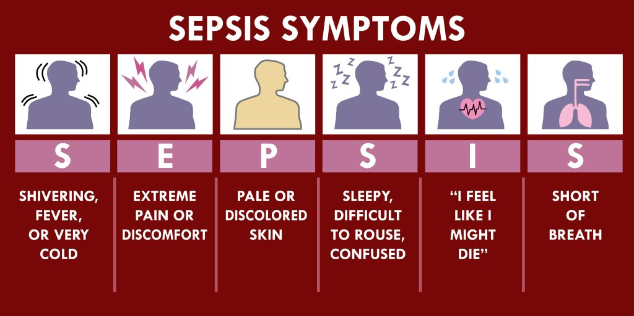
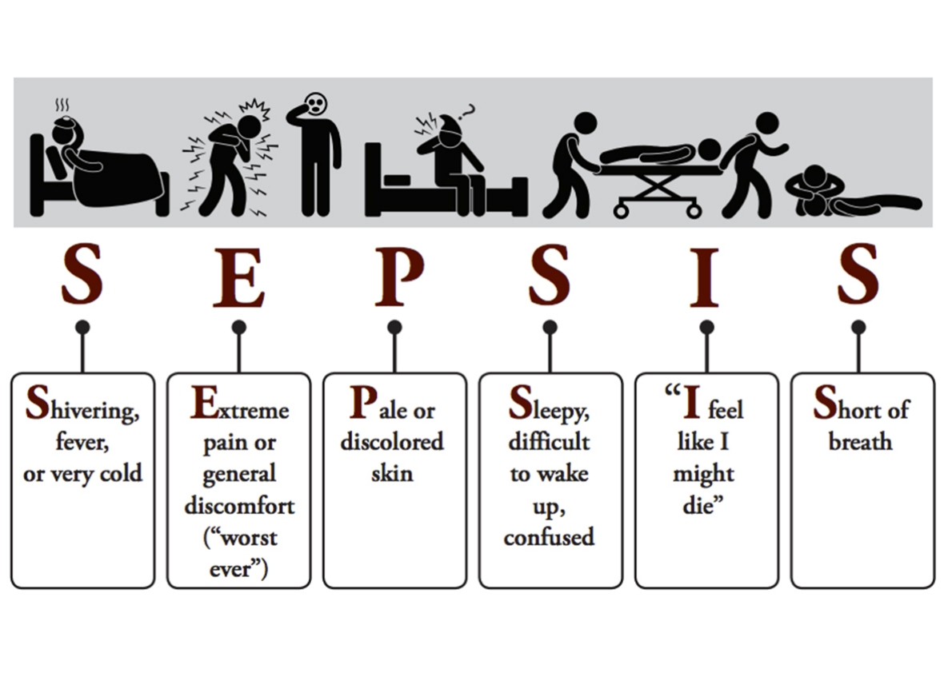

Slide 35
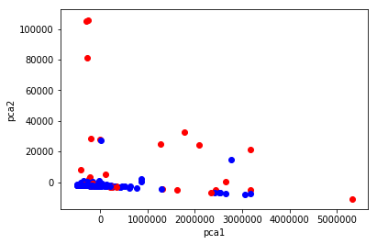
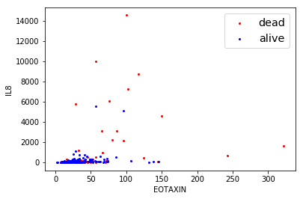
2-dimensional visualization
Red = dead, blue = survived
Clustering did not yield good results

Slide 36
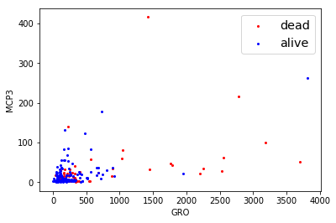
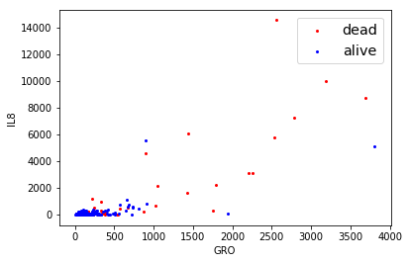

Slide 37
What do cytokines do?
Regulation and mediation of processes in our bodies

Slide 38
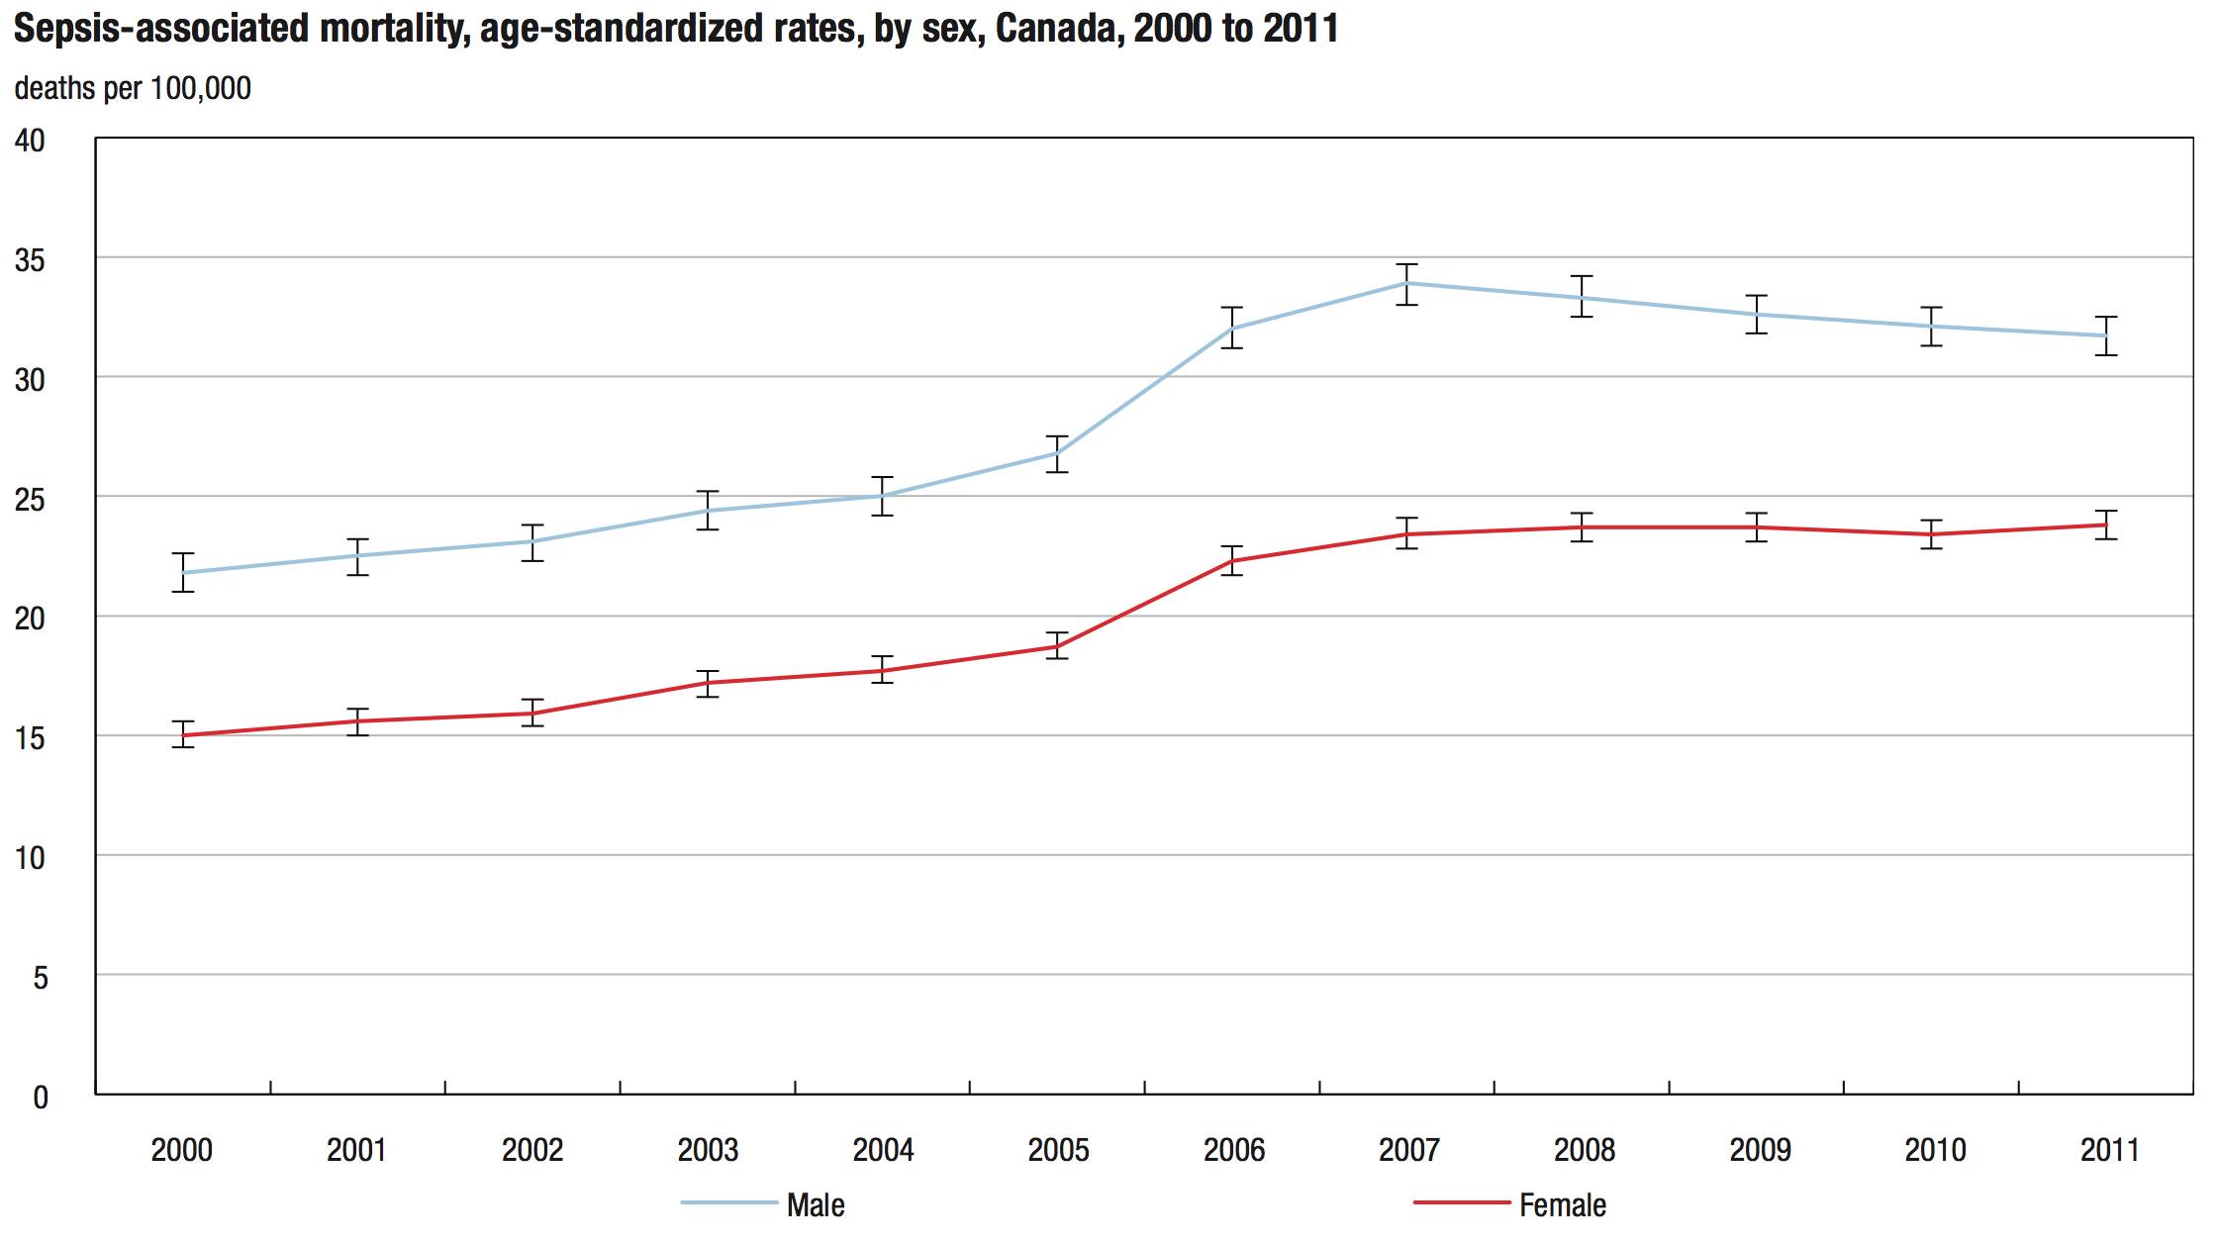
Septic shock: How big of a problem is it?
1 in every 18 deaths in Canada is sepsis re
Around 33% mortality rate within the first month

Slide 39
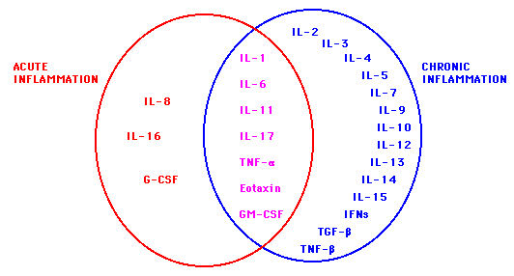
Cytokines and their role

Slide 40
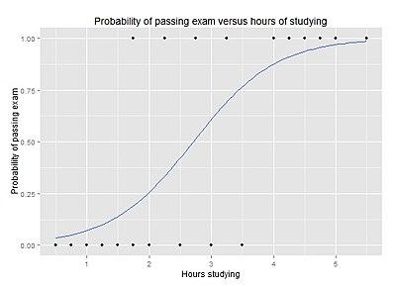
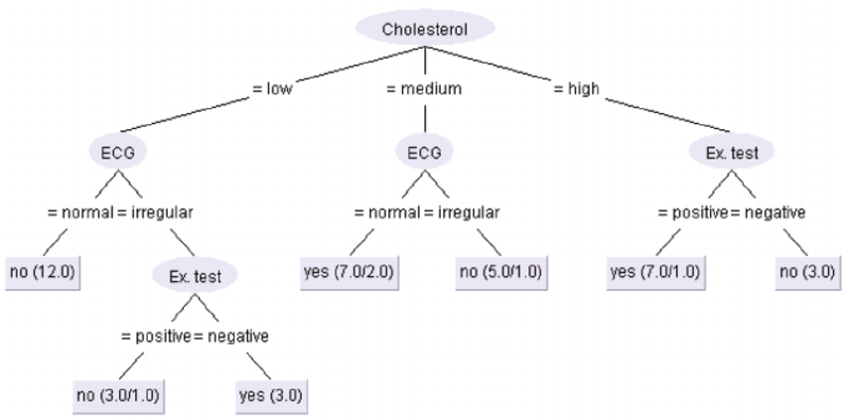
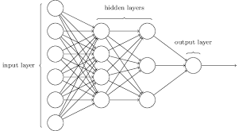
Statistical techniques
Logistical regression: binary classifier
Fit y=f(x), where y is binary and f is of the form 1/(1+exp(a+bx))
T-test: test whether two sets of numbers has the same mean
Decision tree
Neural network

Slide 41
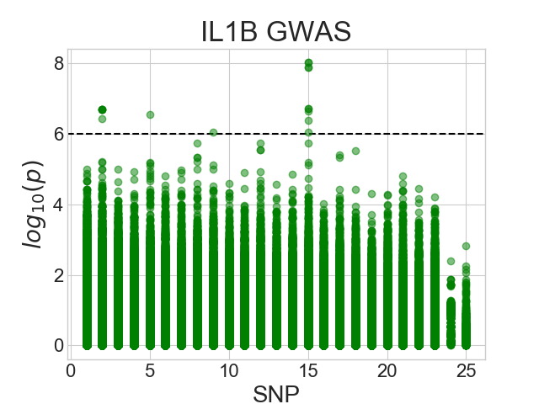
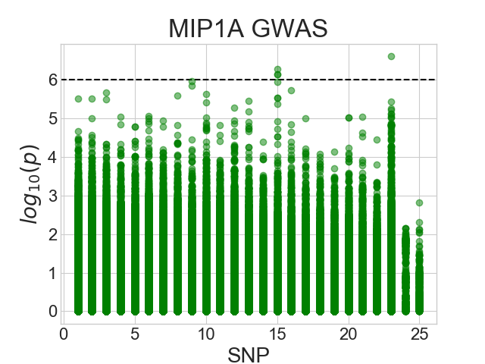
GWAS: what are Manhattan plots?
Probability that association was not by chance

